Slide 1


InstruGen A.I.
PRESENTED TO : Prof. Shouvik Roy
NAME | CWID
Satyam Rajput | A20537375
Gaurav Shivaprasad | A20584775
Priyanka Gaikwad | A20551088
Naman Singh Bajgoti | A20574372
Divyanshi Oberoi | A20577027

Slide 2

Gen. A.I. revolutionizing the world
Gen A.I. : ML models learn data patterns to generate novel content (text, graphics, music, code).
Uses: Powers chatbots (ChatGPT, Claude, DeepSeek), content creation, software development, healthcare, education, & automation.
Gen A.I. in music generation: Automates composition, boosts creativity, personalizes output, and speeds up production.

Slide 3
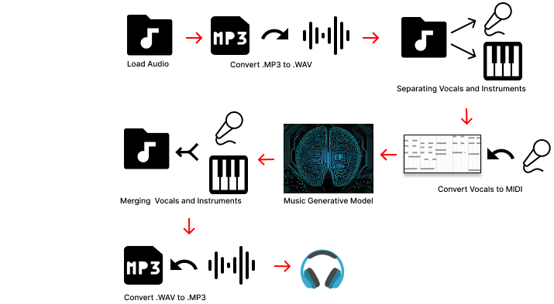
InstruGen A.I.
ML-Driven Instrument Renditions:
Build a user-centric deep learning system to produce instrument-specific song versions without sacrificing musical expressiveness.
Dynamic Instrument Modification:
Integrate advanced audio feature extraction and sequence modeling to support on-the-fly instrument changes, maintaining the original emotional contour of the piece.
Enhanced Model Optimization:
Refine and optimize existing deep learning architectures for superior instrument separation, yielding high-quality, personalized music outputs at scale.
Figure 1: Workflow of Instrumental Music Generation Process

Slide 4
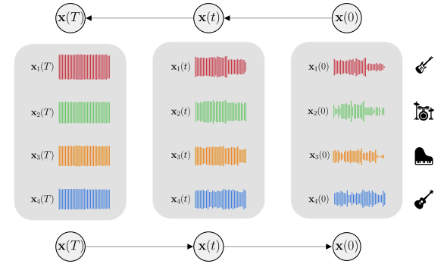
Research Background
Recent Advances in AI-Generated Music ​
MusicGen: A transformer-based model that generates high-quality music from text or melody inputs, simplifying the process with a single-stage architecture. [1]
FTG for Music: A diffusion model technique that improves symbolic music generation by guiding it with fine-grained composer-like constraints. [2]
Multi-Source Diffusion: A model that generates and separates music simultaneously by learning the joint probability of different sound sources. [3]
FIGARO: A transformer-based model enabling controlled music generation using learned and expert-defined features for better style transfer. [4]
Figure 2: Our survey concludes that a step-by-step process captures instrument interactions by introducing and then removing noise. This allows for generating, modifying, or separating instruments while maintaining musical quality.[1]
Notes:
Copet, Jade, Felix Kreuk, Itai Gat, Tal Remez, David Kant, Gabriel Synnaeve, Yossi Adi, and Alexandre Défossez. "Simple and controllable music generation." Advances in Neural Information Processing Systems 36 (2024).
Zhu, Tingyu, Haoyu Liu, Zhimin Jiang, and Zeyu Zheng. "Symbolic Music Generation with Fine-grained Interactive Textural Guidance." arXiv preprint arXiv:2410.08435 (2024).
Mariani, Giorgio, Irene Tallini, Emilian Postolache, Michele Mancusi, Luca Cosmo, and Emanuele Rodolà. "Multi-source diffusion models for simultaneous music generation and separation." arXiv preprint arXiv:2302.02257 (2023).
von Rütte, Dimitri, Luca Biggio, Yannic Kilcher, and Thomas Hofmann. "FIGARO: Controllable music generation using learned and expert features." In The Eleventh International Conference on Learning Representations. 2023.

Slide 5
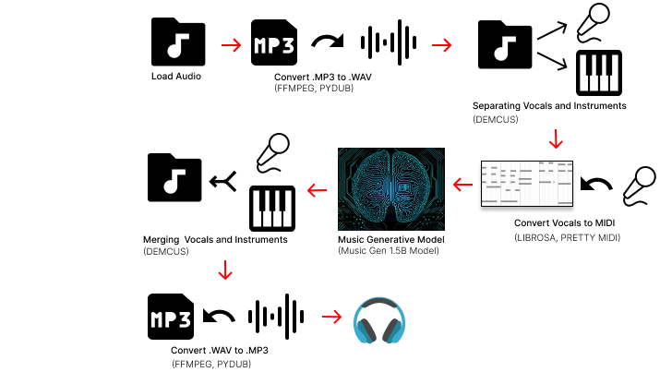
Data Collection, Processing and Libraries
Dataset:
1. Lake Midi dataset[1]
2. MAESTRO dataset[2]
3. Nsynth dataset[3]
Data processing:
1. MIDI to Structured Format:
Extract features like pitch, velocity, duration, tempo, time signature, and instrument type.
Encode data into a tokenized format compatible with the model.
2. Normalization
Standardize MIDI data to ensure uniformity across datasets for optimal model training.
Libraries
Figure 3: Libraries used in the workflow of Instrumental Music Generation Process
Notes:
https://colinraffel.com/projects/lmd/
https://magenta.tensorflow.org/datasets/maestro
https://magenta.tensorflow.org/datasets/nsynth

Slide 6
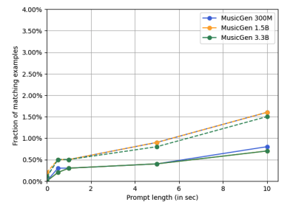


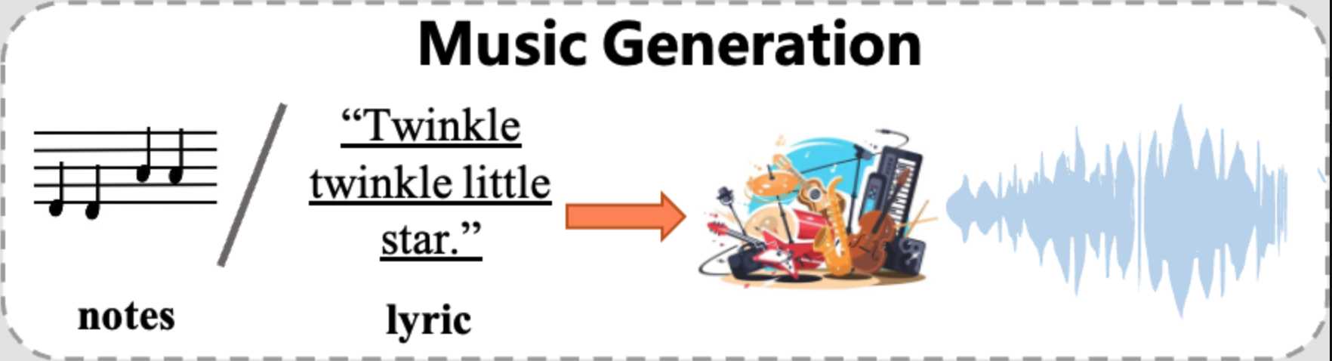
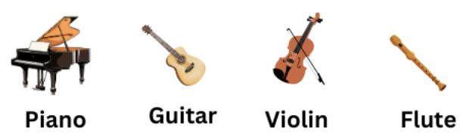
Phase I: Milestones & Challenges
Dataset Collection & Diversity:
Integrated diverse datasets such as MAESTRO, NSynth, and Lakh MIDI to ensure a comprehensive and high-quality training dataset.
Base Model Selection
Selected a base model aligned with the project’s objective of generating instrument-specific music by replacing vocal tracks.
Pipeline Development:
Initially, the challenge was to directly input raw MP3 files and generate instrumentals. To address this, we built a structured workflow to convert MP3 inputs into raw MIDI files, ensuring seamless data preparation for model training.
Instrument-Specific Nuances
Addressed challenges in capturing instrument-specific characteristics by fine-tuning models like Demucs and Spleeter with instrument-specific augmentations
Figure 4. Dataset Sources: Utilizing MAESTRO and NSynth from Magenta, along with Lakh MIDI from Kaggle.
Figure 5. Model Selection: MusicGen Medium (1.5B parameters) for its balance of efficiency and performance, offering results close to the 3.3B version while being more fine-tuning friendly.[2]
Figure 6. Pipeline Development: Designed a structured workflow to convert MP3 inputs into raw MIDI files, ensuring seamless data preparation for model training.
Figure 7. Instrument-Specific Nuances:
Fine-tuned Demucs and Spleeter with instrument-specific augmentations for better separation and synthesis.
Notes:
1. https://magenta.tensorflow.org/, https://www.kaggle.com/.
2. https://arxiv.org/pdf/2306.05284
3. https://arxiv.org/html/2404.09313v1
4. Image src: https://mrmrsenglish.com/types-of-musical-instruments-names/

Slide 7
Phase I: Milestones & Challenges
Data Transformation
Real-Time Processing
Achieving real-time efficiency during model inference while maintaining high accuracy and minimizing latency.
Model Optimization
Balancing model accuracy and training efficiency, especially for instrument-specific embeddings, within the computational limitations.
Resource Constraints
Optimizing the processing pipeline to achieve quick and accurate results during inference without significant resource consumption.
Ensuring seamless conversion of raw MP3 files into MIDI format while maintaining the quality of musical nuances.

Slide 8
Project Timeline
PHASE I (Research & Data Preparation)
PHASE II ( Model Training & Optimization )
PHASE III ( Advanced Testing & Refinement )
Exploration of Existing Models
Dataset Acquisition & Preprocessing
Base Model Selection
Fine-Tuning the Base Model
Optimization & Performance Tuning
Evaluation & Testing
Enhancing Instrument Articulation
Comparative Model Testing
Iterative Refinement with Feedback

Slide 9
Phase 2

Slide 10




Steps for Building Efficient Model
Data Gathering
Data Cleaning
Collect Single Instrument Data: Gather datasets through targeted online searches, ensuring the data focuses on one instrument and is sourced from reliable platforms.
Dataset: Dataset resources from kaggle[1][2]
Remove Irrelevant/Corrupted Data: Identify and discard incomplete or duplicated files to minimize noise.
Standardize File Formats: Convert all audio to a uniform sample rate and bit depth; ensure all MIDI files follow a standardized structure .
Data Augmented
Splitting of Data
Apply Diverse Transformations: Integrate noise addition, pitch shifting, random cropping, and time stretching to simulate varied recording conditions.
Enhance Model Performance: These methods simulate different acoustic conditions, improving the model's robustness and generalization.
Train/Validation/Test Split: Partition the dataset into training (majority), validation (for hyperparameter tuning), and test sets (for final evaluation) to prevent overfitting.
Maintain Pairing Consistency: For paired audio-MIDI data, ensure files are split consistently (i.e., an audio file and its corresponding MIDI remain in the same
subset).
Notes:
[1]https://www.kaggle.com/datasets/jbraga/traditional-flute-dataset
[2]https://www.kaggle.com/datasets/ashkhagan/the-vienna-4x22-piano-corpus

Slide 11
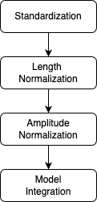
Preprocessing of Dataset
Standardization:
Loads audio and converts it to mono
Resamples to target sample rate of 32000 Hz
Trims silence from audio files
Length Normalization:
Pads short audio with silence or truncates long audio to fixed length (10 seconds default)
Ensures all examples have consistent dimensions for batch processing
Amplitude Normalization:
Uses librosa.util.normalize to standardize audio volume
4. Model Integration:
Handle MusicGen's multi-codebook architecture (4 codebooks)
Figure 8. Flow of Data Preprocessing

Slide 12
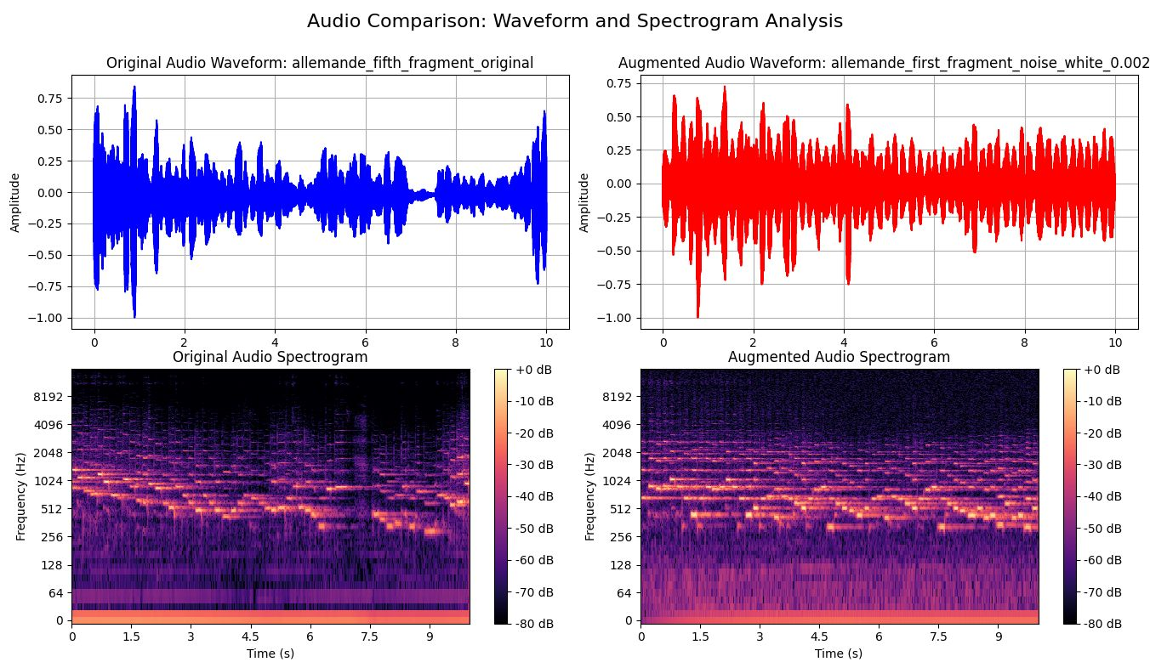
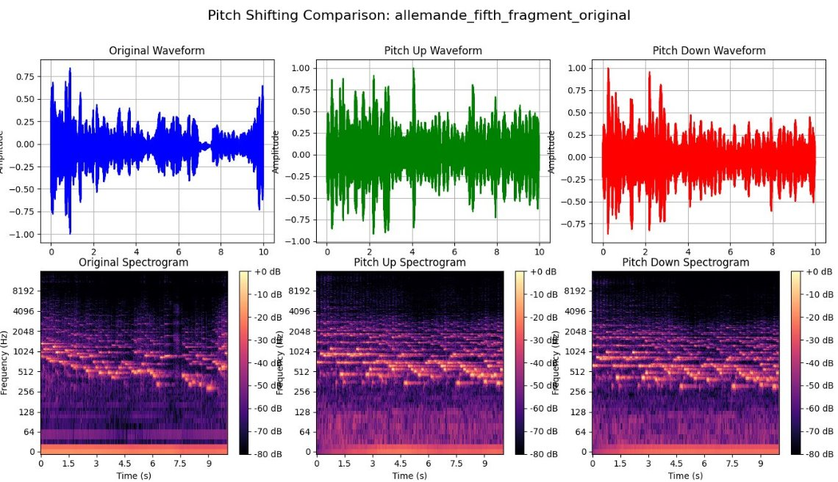
Data Augmentation with Noise Addition and Pitch Shifting
Noise Addition:
In this process we make models robust to real-world conditions by simulating recording imperfections or environmental noise.
We have added the white noise, pink noise and Gaussian noise.
Pitch Shifting:​
In this process we alters the frequency of an audio signal or changes the pitch of MIDI notes without affecting the duration.​
We have added pitch shifting with pitch up and pitch down without affecting speed(tempo).
Figure 9. Data Augmentation with Noise Addition
Figure 10. Data Augmentation with Pitch Shifting

Slide 13
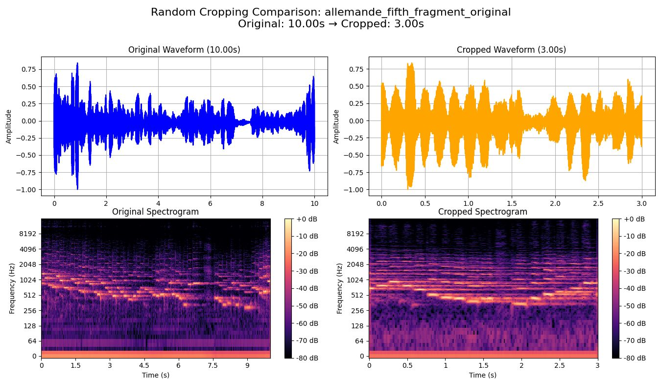
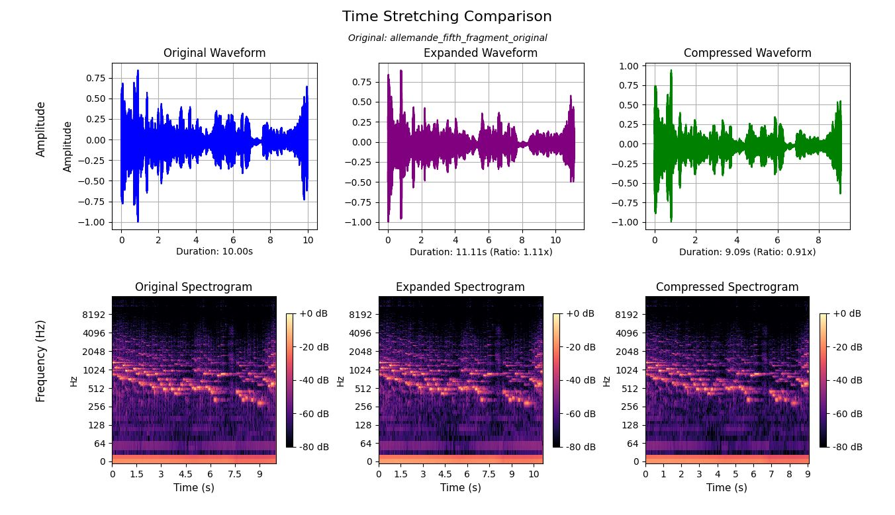
Data Augmentation with Cropping and Time Stretching
Cropping:
This process involves selecting a specific portion of the audio or midi file, which is useful for augmentation and training on different segments.
We have cropped the specific time in the original file randomly.
Time Stretching:​
It changes the speed of audio or MIDI performance while preserving pitch.​
It changes the tempo to fast and slow while preserving pitch.​
Figure 11. Data Augmentation with Cropping
Figure 12. Data Augmentation with Time Stretching

Slide 14

MusicGen Model
Overview
Single-Stage Transformer: Processes audio tokens in one shot (unlike multi-stage/hierarchical setups).
High-Fidelity Generation: Trained on a large music corpus, capturing broad rhythms, melodies, and timbres.
Controllability: Accepts text or melodic prompts to guide music style and content.
Why MusicGen?
Pre-Trained Knowledge: Leverages a vast dataset of diverse music for robust initial performance.
Efficiency: Less complex than multi-stage diffusion or hierarchical models, making fine-tuning more straightforward.
Strong Baseline: Consistently outperforms many earlier text-to-music methods in quality (FAD, KL) and text relevance (CLAP score).
How We Use It in Our Project?
Transfer Learning: We adopt MusicGen’s learned music "understanding" (pitch, structure, harmony).
Fine-Tuning InstruGen: We add specialized layers or adjust certain weights to focus on instrument-specific generation.
Custom Tasks: Tailor the model for tasks like instrument replacement, music separation, and unique dataset requirements.

Slide 15
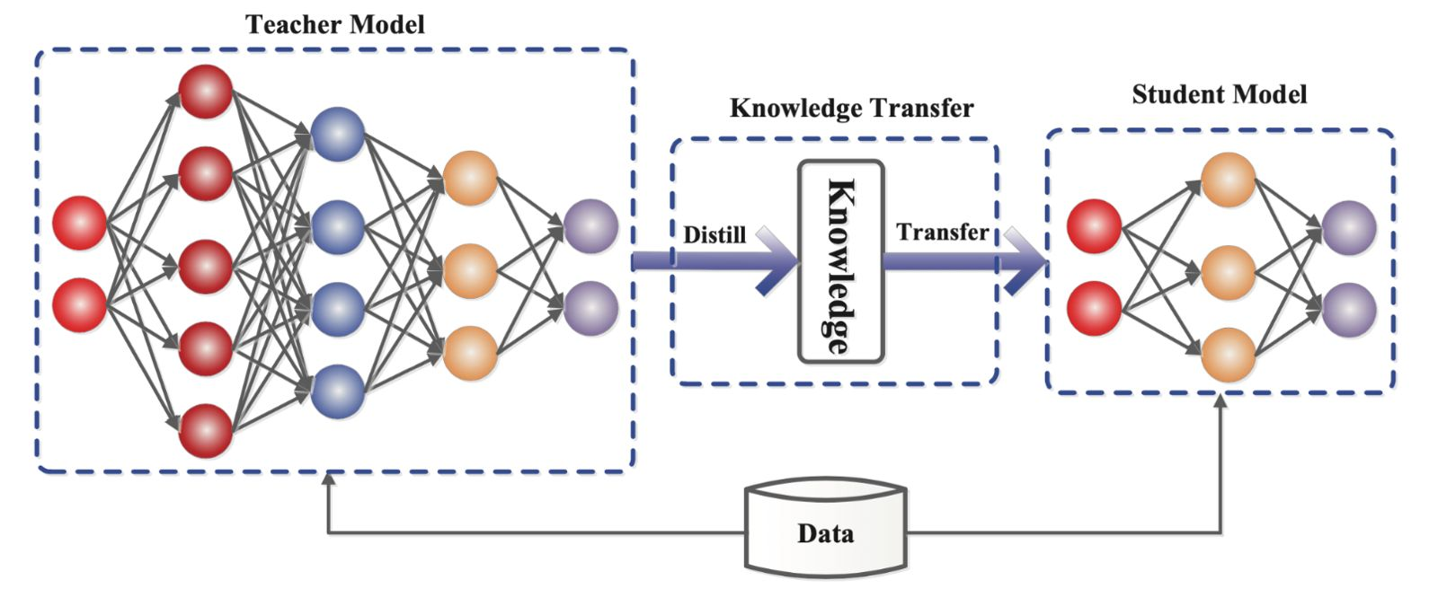
Knowledge Distillation
Knowledge Distillation:
Reusing distilled knowledge from a teacher model to improve performance in a smaller, student model.
Why Knowledge Distillation?
Create smaller, more efficient models that retain much of the teacher's performance.
Easier to deploy in resource-constrained environments.
Smaller models generally offer quicker predictions.
How We Apply It
Teacher Model: Start with MusicGen as a high-performing.
Student Model: Train a smaller, specialized model that mimics the teacher's behavior using its output as soft targets.
Distillation Process: During training, the student learns to match the teacher's outputs, which contain not just the final decision but also the underlying probability distributions (soft labels), capturing more nuanced knowledge.
Expected Outcome
Smarter Student: The student model absorbs complex patterns, leading to faster learning and similar performance as the teacher model.
Efficiency: While the student model is smaller, it leverages the teacher’s learned knowledge to achieve high-quality outputs with fewer parameters.
Flexible: The process allows for easy adaptation to new instruments or musical styles with minimal retraining.
Figure 13. Knowledge Transfer Flow

Slide 16
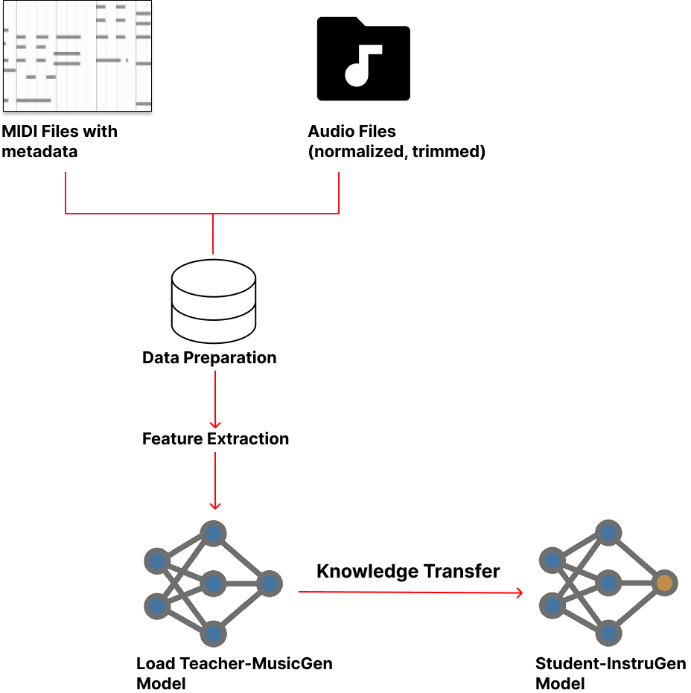
InstruGen Model
Model training using Knowledge Distillation for MIDI-to-WAV Generation
Load Data – Import the audio and MIDI files for data preparation.
Feature Extraction – Extract relevant features from the loaded files.
Load Teacher Model – Initialize the Teacher Model for knowledge distillation.
Knowledge Distillation – Transfer knowledge from the Teacher Model to the Student Model.
Load Student Model – Initialize the Student Model with the distilled knowledge.
InstruGen Model– Input MIDI files into the Student Model to produce WAV format files, ensuring output similarity to the Teacher Model.
Figure 14. Workflow of InstruGen Model

Slide 17
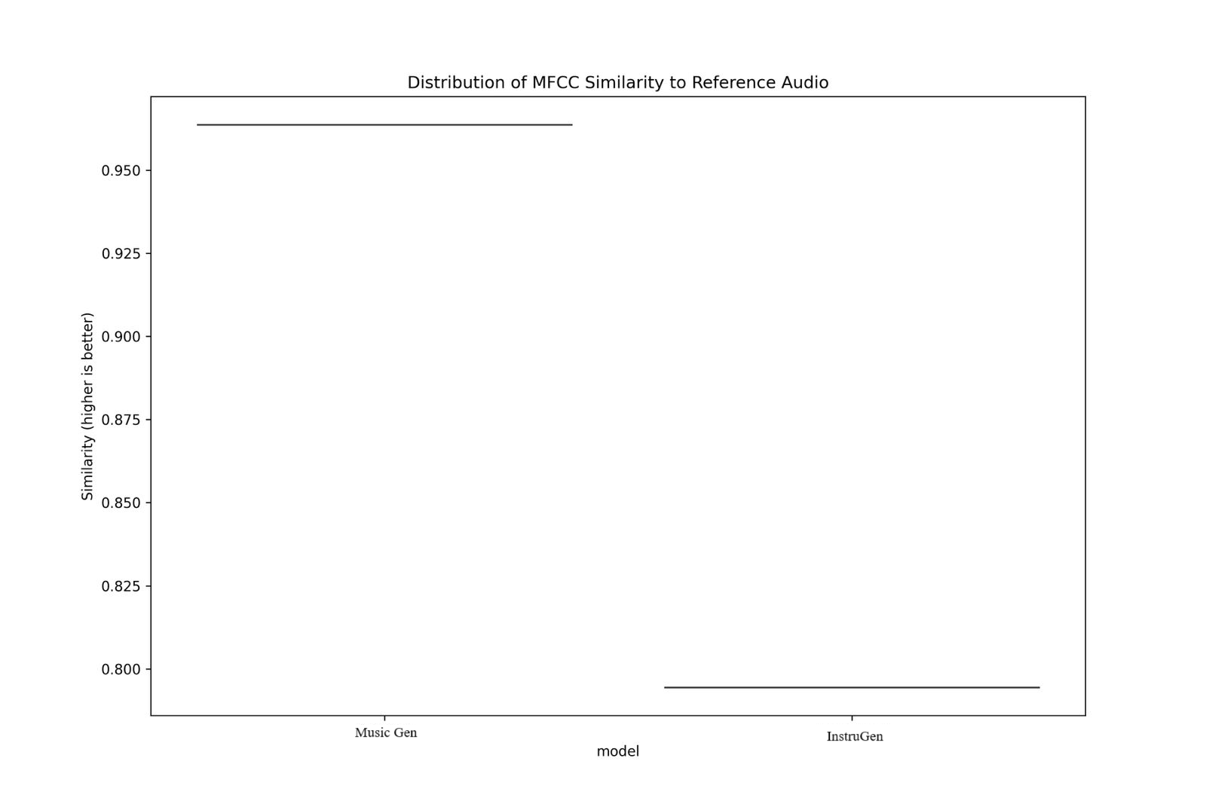
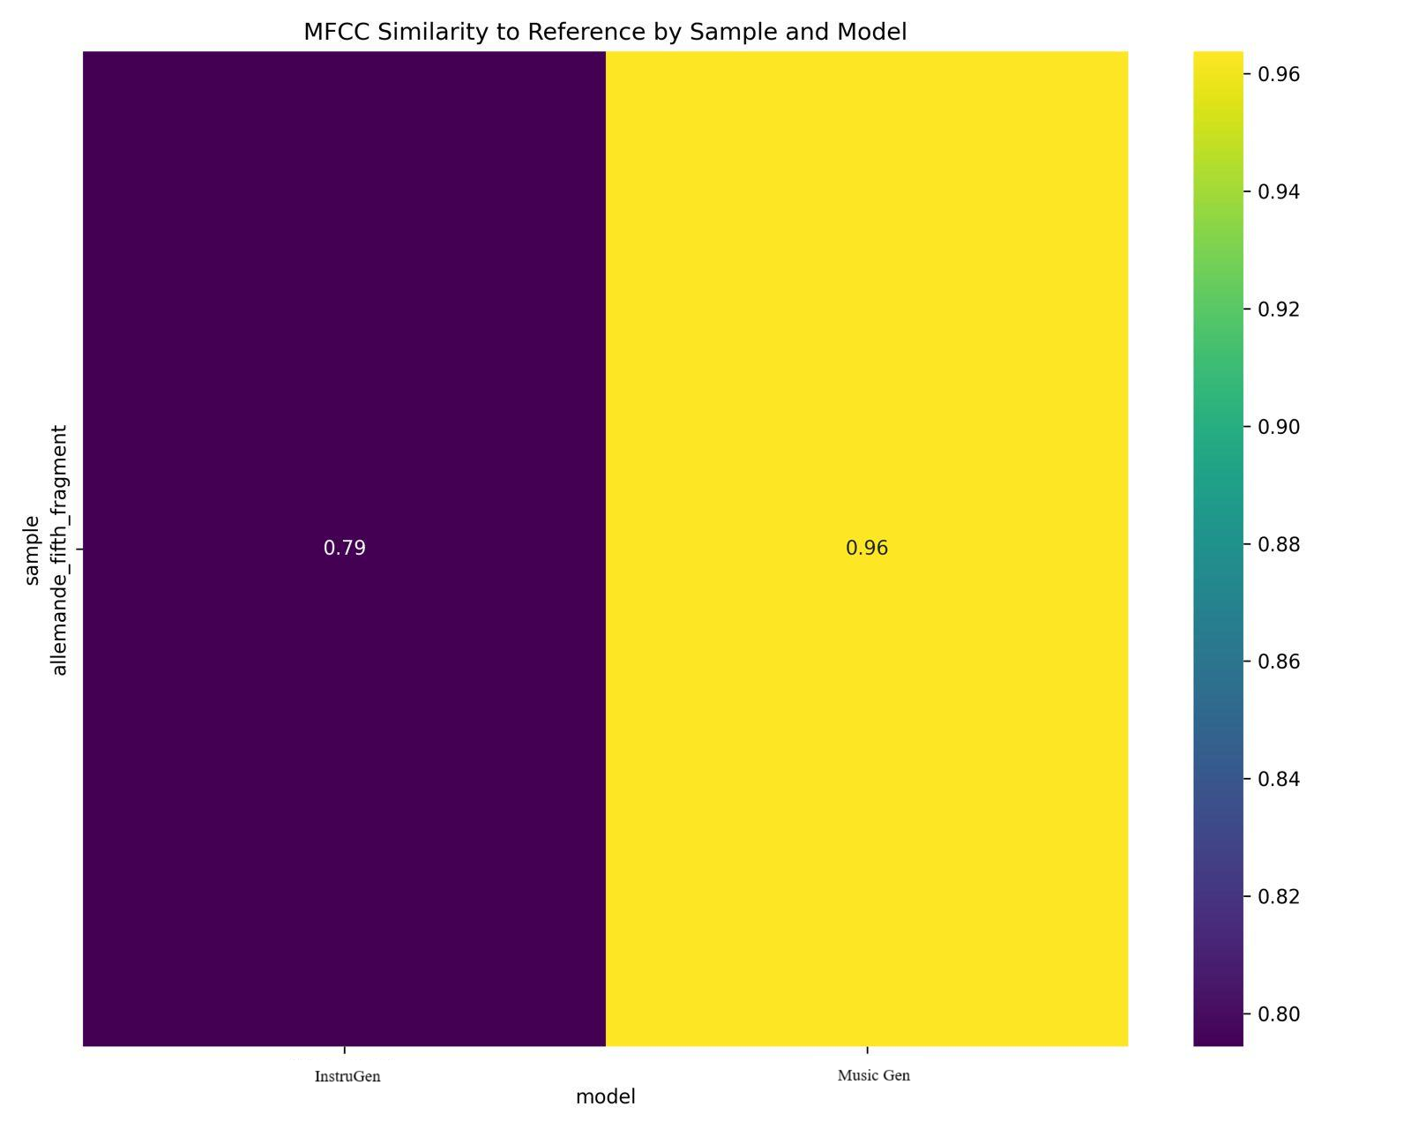
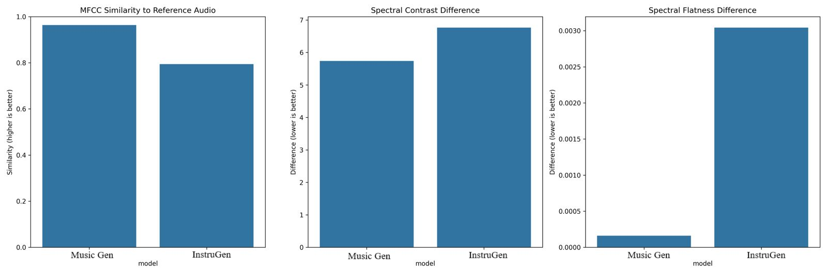
Music Gen Vs InstruGen
The initial training results after 5 epochs on 11 data samples indicate promising performance, with expectations of improved accuracy when trained on a larger dataset.
Figure 15. Distribution of MFCC Similarity to Audio in both models
Figure 17. MFCC Similarity to Reference by the Sample and Model
Figure 16. Spectral Contrast and Spectral Flatness Difference

Slide 18
Challenges in Phase 2
Data Collection
Model Training
Challenge: MusicGen designed for audio (WAV), not symbolic (MIDI) data → architectural adjustments needed.
Challenge: Limited dataset risks overfitting → model reproduces existing tracks, not novel compositions.
Resolution: Expand dataset diversity by generating synthetic WAV/MIDI variations (e.g., pitch shifts, tempo changes).
Resolution: Used mido for format conversion without altering file size/track length.
Data Transformation
Challenge: WAV ↔ MIDI conversion is critical but complex; data often exists in only one format.
Resolution:
Train on single-instrument data (flute-only WAV/MIDI) for foundational learning.
Gradually adapt architecture (e.g., dual encoders) to handle multi-format inputs.

Slide 19
Issues to be resolved in final Phase
CPU Utilization
Training the model for large MIDI size requires large CPU utilization.
Data Gathering
Finding dataset for other instruments to train the model on.
output
Realistic Output
Getting the realistic output after replacing the vocals with an instrument

Slide 20
Phase 3 Blueprint
Need to use a system with a dedicated GPU to improve model training with a large dataset.
Train the model with various instruments datasets.
Adding more layers or use regularization techniques in the model training process.
Use Adam optimizer on the model to gain more accuracy of the model in the future.
We will create an interface that takes the audio file and Instrument name which they like to generate the music in.

Slide 21

Thank You
🎶 Keep Listening, Keep Grooving 🎶

